Slide 1
Analysis of Toronto Neighborhoods by Available Sports and Recreational Facilities
April 1, 2021

Slide 2
1. Introduction
For most people moving to a new home, choosing the appropriate neighborhood is one of the most important things to think about. One thing a person must consider is the availability of different establishments and amenities within the area. For sporty or physically active people, having facilities such as a Basketball Court or a Yoga Studio is important sometimes even necessary.
What we would like to answer in this project is what neighborhoods are the most ideal place for a person who is physically active to live in? Furthermore, we would like to see which neighborhoods are similar in terms of the sports and recreational facilities that they can provide. For this project we would be considering all the neighborhoods in the City of Toronto.

Slide 3
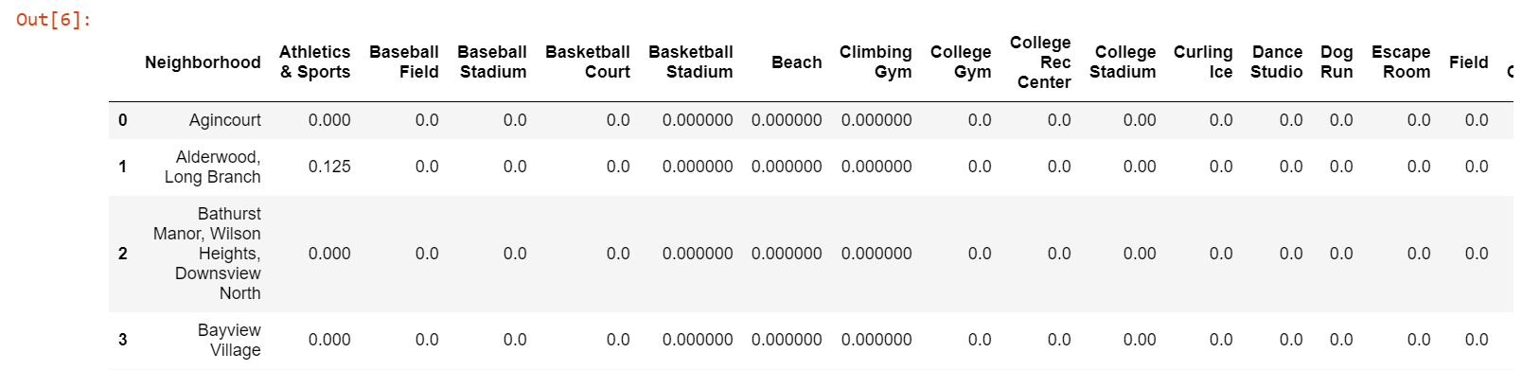
2. Data
To solve the problem, data of all nearby venues for each neighborhood in Toronto will be extracted. Since the venues of interest are sports and recreational venues, only a portion of the Foursquare data will be used.

Slide 4
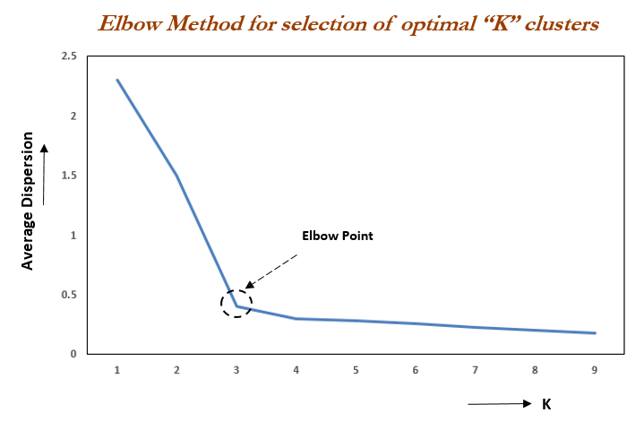
3. Methodology
Elbow Method

Slide 5
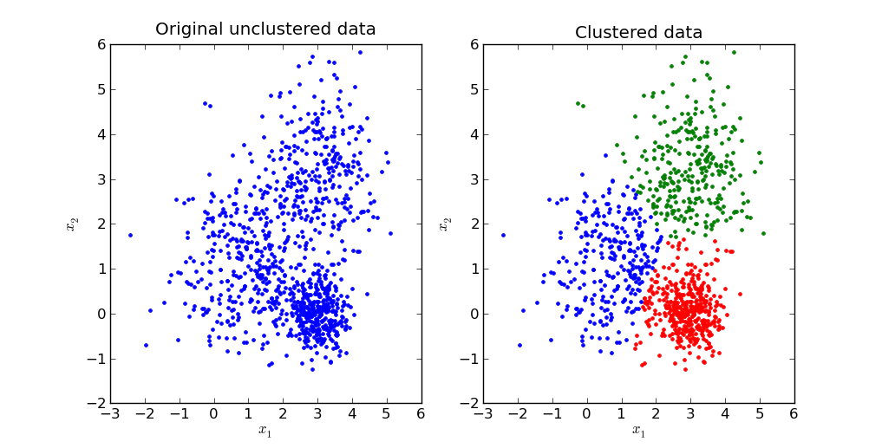
3. Methodology
Cluster Analysis

Slide 6
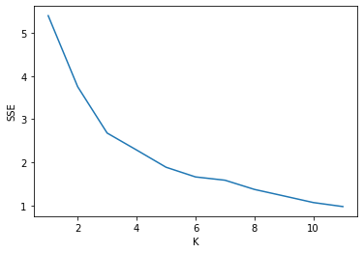
4. Results
Upon inspection of the data, 29 of the 100 neighborhoods listed have no nearby sports or recreational facility. We decided to remove these 29 neighborhoods so that they will not affect the cluster analysis.
Based on the plot below, the most optimal K to use is K=3.

Slide 7
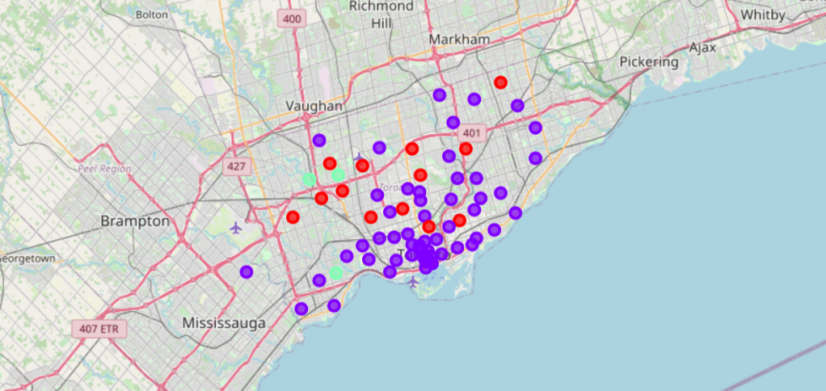
Cluster Map

Slide 8
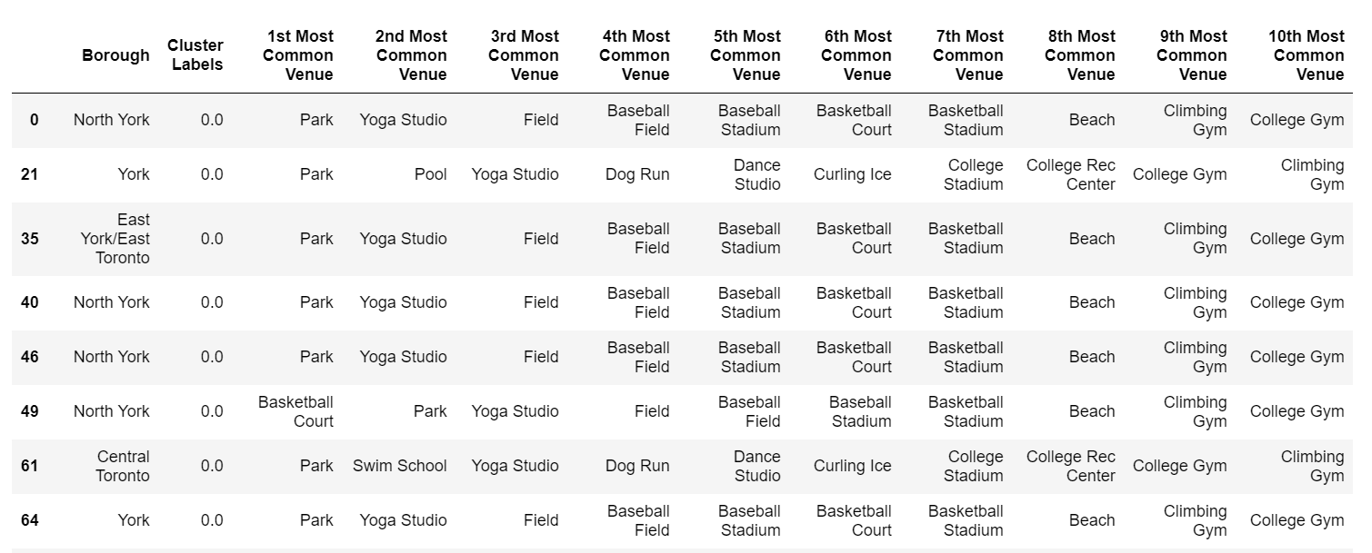
Cluster 1: Park Cluster

Slide 9
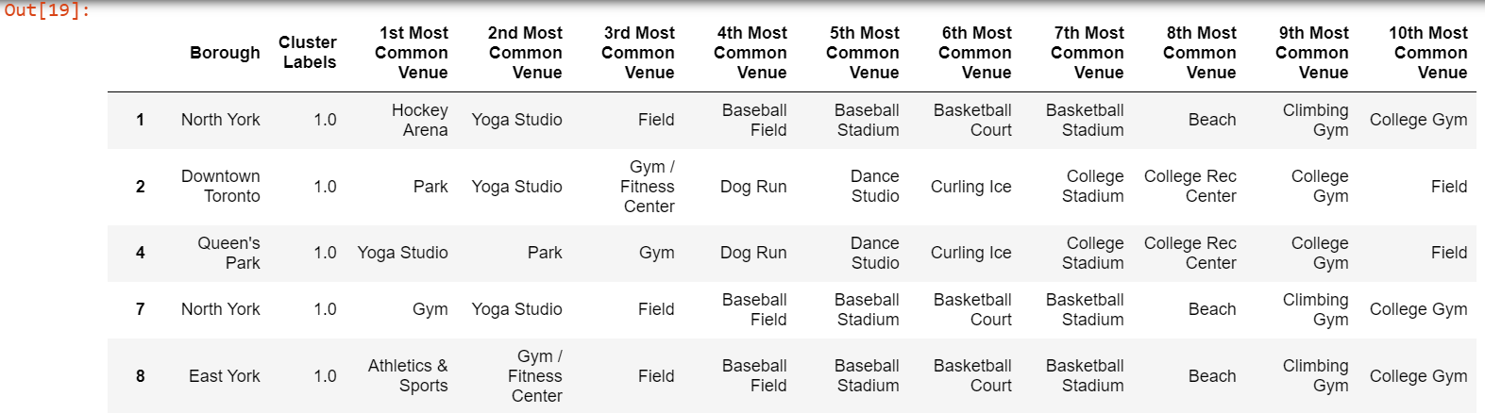
Cluster 2: Variety Cluster

Slide 10
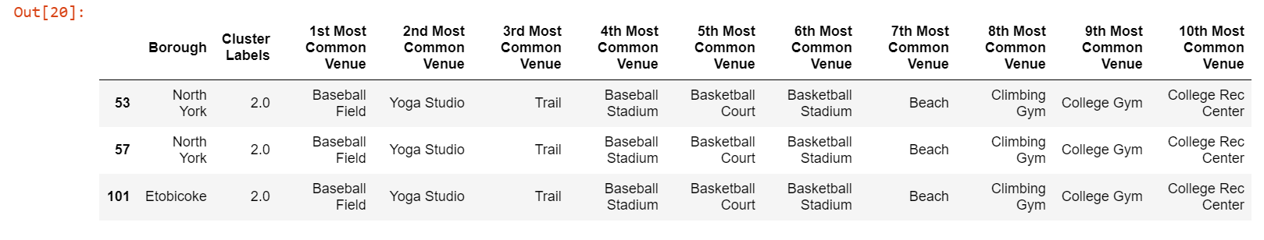
Cluster 3: Baseball Cluster

Slide 11
5. Discussion
In the very beginning of our analysis, we have already seen that there are 29 out of the 100 neighborhoods we checked that have no nearby sports and/or recreational venues. We can safely say that this 29 neighborhoods are not ideal for Physically Active people and/or families.
Among the 3 clusters that we were able to derive, the “Variety Cluster” has the most variety when it comes to available amenities. This cluster of neighborhoods would be good enough for people who do not have a particular sport or activity in mind and is ok with any physical activity.
Cluster 1 or the “Park Cluster” would be ideal for people who enjoy parks or any outdoor activity. There are plenty of activities that can be done in parks such as jogging, walking, biking or outdoor exercise. Furthermore, parks can be enjoy by people of all ages. Thus, this cluster would be suitable for families who are physically active since all members of the family can easily participate in Park activities.
The last cluster is the “Baseball Cluster” which has Baseball Fields as the most common sports venue. This cluster would be ideal for people and families who enjoy playing or watching baseball.

Slide 12
6. Conclusion
In conclusion, there are many neighborhoods in Toronto that are ideal for physically active or sporty families. Among the 100 Neighborhoods observed, 29 are not ideal for physically active or sporty families as they do not have any nearby sports or recreational venues. The result of our analysis is that 3 clusters is optimal. The three clusters that we have created are labelled as the Park Cluster, Variety Cluster and Baseball Clusters. Park Cluster is ideal for Physically Active Families while the Baseball Cluster is ideal for any Baseball loving individuals or families. The Variety Cluster is ideal for anyone who do not have a particular sport or physical activity in mind as they have a variety of available sports or recreational venues.

